Slide 1
Welcome to Virtual 1st Grade Open House

Slide 2
TEACHER INTRODUCTIONS
Face to Face Teachers
Ms. Carrie Austin
Mrs. Andrea Chapman
Mrs. Kimberly Foster
Mrs. Kim Wilson
Virtual Teachers
Ms. Gracie Austin
Mrs. Beth Harwell
Mrs. Carrie Reuss

Slide 3
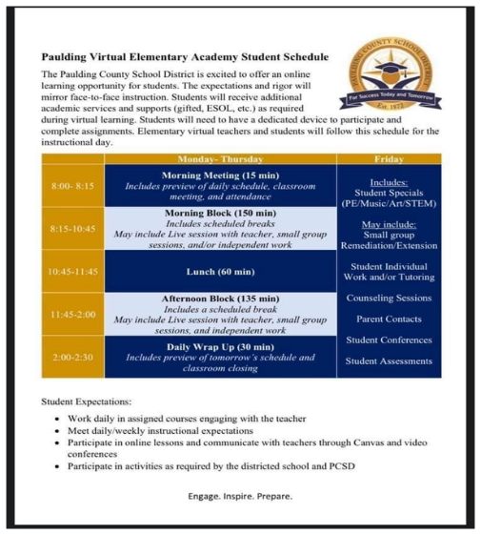
VIRTUAL SCHEDULE

Slide 4
DIGITAL VS. VIRTUAL LEARNING
This school year your child will be participating in virtual learning. Virtual learning is vastly different than what we did last school year.
Digital Learning
No direct teacher instruction
Teacher has office hours
For short periods of time, such as inclement weather days
Virtual Learning
Direct teacher instruction
Specific daily schedule
Attendance taken daily

Slide 5
PARENT PORTAL
As a school district, we value partnerships with our families and open communication regarding student progress. Infinite Campus Parent Portal is a tool for parents and students to remain up-to-date regarding their students’ daily progress.
First time users to Parent Portal are required to establish a user identification which includes both alpha and numeric characters.
Below is information regarding how to obtain an account activation code, as well as reset accounts, if needed.
COVID-19 Instructions for Activating a Parent Portal Account
Please send an email to portal@paulding.k12.ga.us and the following information. A copy of parent picture id must also be included in the email. Parent Name
Parent Physical Address
Parent Email Address
Student First Name
Student Last Name
Student’s Date of Birth
Student(s) Physical Address
Name of School Student Attends

Slide 6
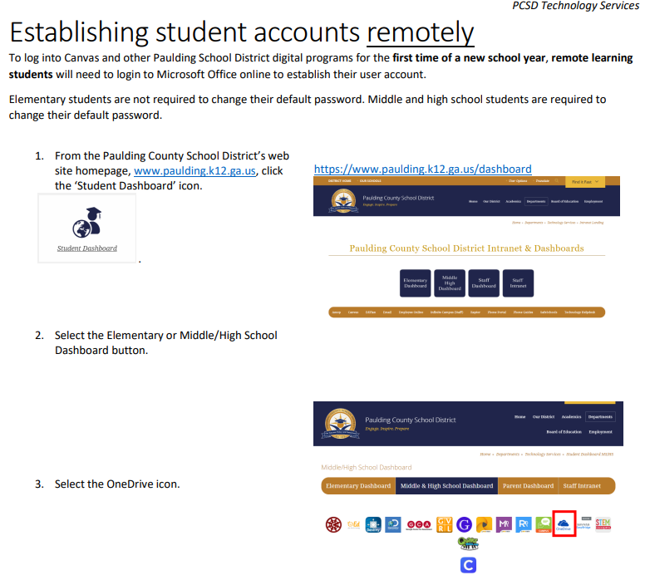
REMOTE ACCOUNT ACCESS

Slide 7
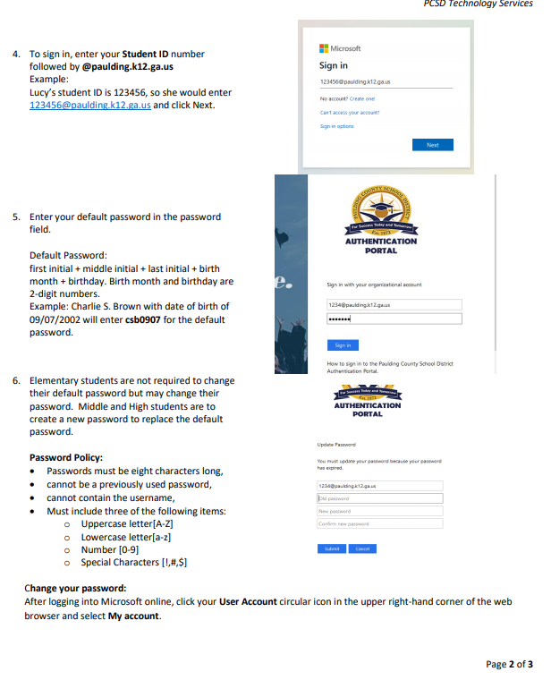
REMOTE ACCOUNT ACCESS

Slide 8
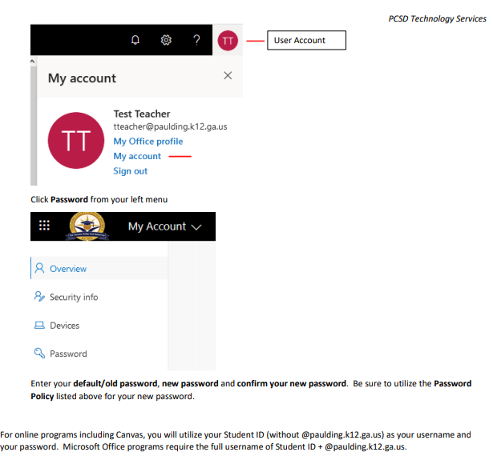
REMOTE ACCOUNT ACCESS

Slide 9
SUPPLIES
Virtual students will need to purchase the same supplies as face-to-face students. They will need these things at home to complete daily work.
· Crayons (2) ~ Recommend Crayola 24 count
· Tissues (2)
· Pencils ~ Recommend Dixon Ticonderoga brand and sharpener
· Zipper pouch with binder rings (2)
· Scissors ~ Recommend Fiskar brand
· Glue sticks (6) ~ Recommend Elmer’s brand
· Composition Notebooks wide ruled (4)
· Dry Erase board and markers (skinny)
· Large Pink Pearl erasers
· Pack of Copy Paper
· Index Cards
· Cap Erasers

Slide 10
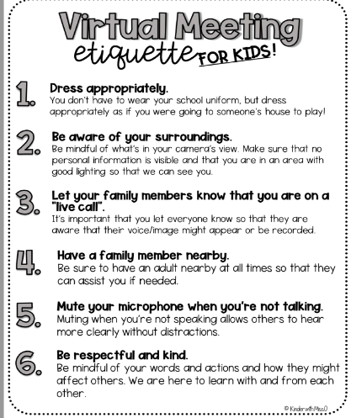
VIRTUAL CLASS RULES

Slide 11
VIRTUAL ATTENDANCE
Our morning meeting will be from 8:00 – 8:15 and students will be expected to attend. Attendance will be taken and reported to the office.
Attendance is required at all live session including small group sessions.
Refer to the handbook for the county attendance policy.

Slide 12
COMMUNICATION
Newsletters- Sent home weekly (electronically)
Canvas- Letter sent home with details
Email – Be sure we have an active
e-mail address on file.
Phone –Hiram Elementary 770-443-3392

Slide 13
WHAT IS A SYLLABUS?
A syllabus is something that comes home at the beginning of each quarter (9 weeks).
Listed on the syllabus are all of the new standards that will be assessed
throughout that quarter. Please note that we assess previously taught standards throughout the year to ensure mastery.

Slide 14
BOOKWORMS
Balanced Reading Program that consists of 3 parts
Shared Reading- On Grade Level Texts (Whole Group)
DI Box Time- Direct Instruction
(Small Group Setting)
Interactive Read Aloud/Writing
(Whole Group, Partner, Individual)

Slide 15
MATH WORKSHOP
Consists of 3 parts:
Opening (Whole Group)
Work Time~ Independent Work
Closing~ (Whole Group)

Slide 16
HOMEWORK
Read 10-20 minutes every night.
Practice reading sight words nightly.
Daily math reinforcement practice.
Math fact practice.

Slide 17
LOOKING AHEAD
We look forward to working with all of you this year! Let’s make it a great one!

